Slide 1
MINI PROJECT REVIEW - 02 III YEAR / II SEMESTER
ACADEMIC YEAR : 2024 –25
< Group Number: 01 >
PROJECT TITLE – EDUMORPH ( AI POWERED LEARNING)
By
Bobbili Ruchilasya 23QM5A6601
Manish Kanyaboyina 22QM1A6626
Vivekananda Bojjanolla 22QM1A6605
GUIDE:
MR.M.VISHNU VARDHAN
ASSISTANT PROFFESOR
CSE-AIML

Slide 2
PROBLEM STATEMENT:
Students and professionals struggle to extract key points from large PDFs because manually searching for important information is time-consuming. Students need to revise quickly before exams but often face delays due to inefficient summarization. Professionals also require fast and accurate answers for their work but find it difficult to sift through lengthy documents. Existing AI tools provide general summaries, which often miss crucial details needed for effective learning or decision-making. As a result, both students and professionals experience frustration and inefficiency in their studies and work.

Slide 3
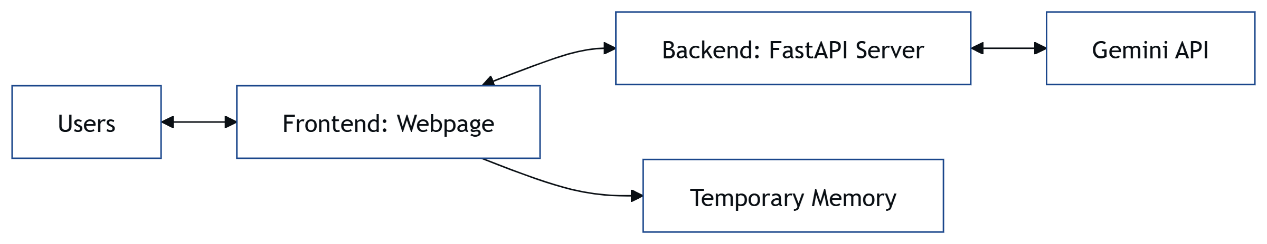
SYSTEM ARCHITECTURE

Slide 4
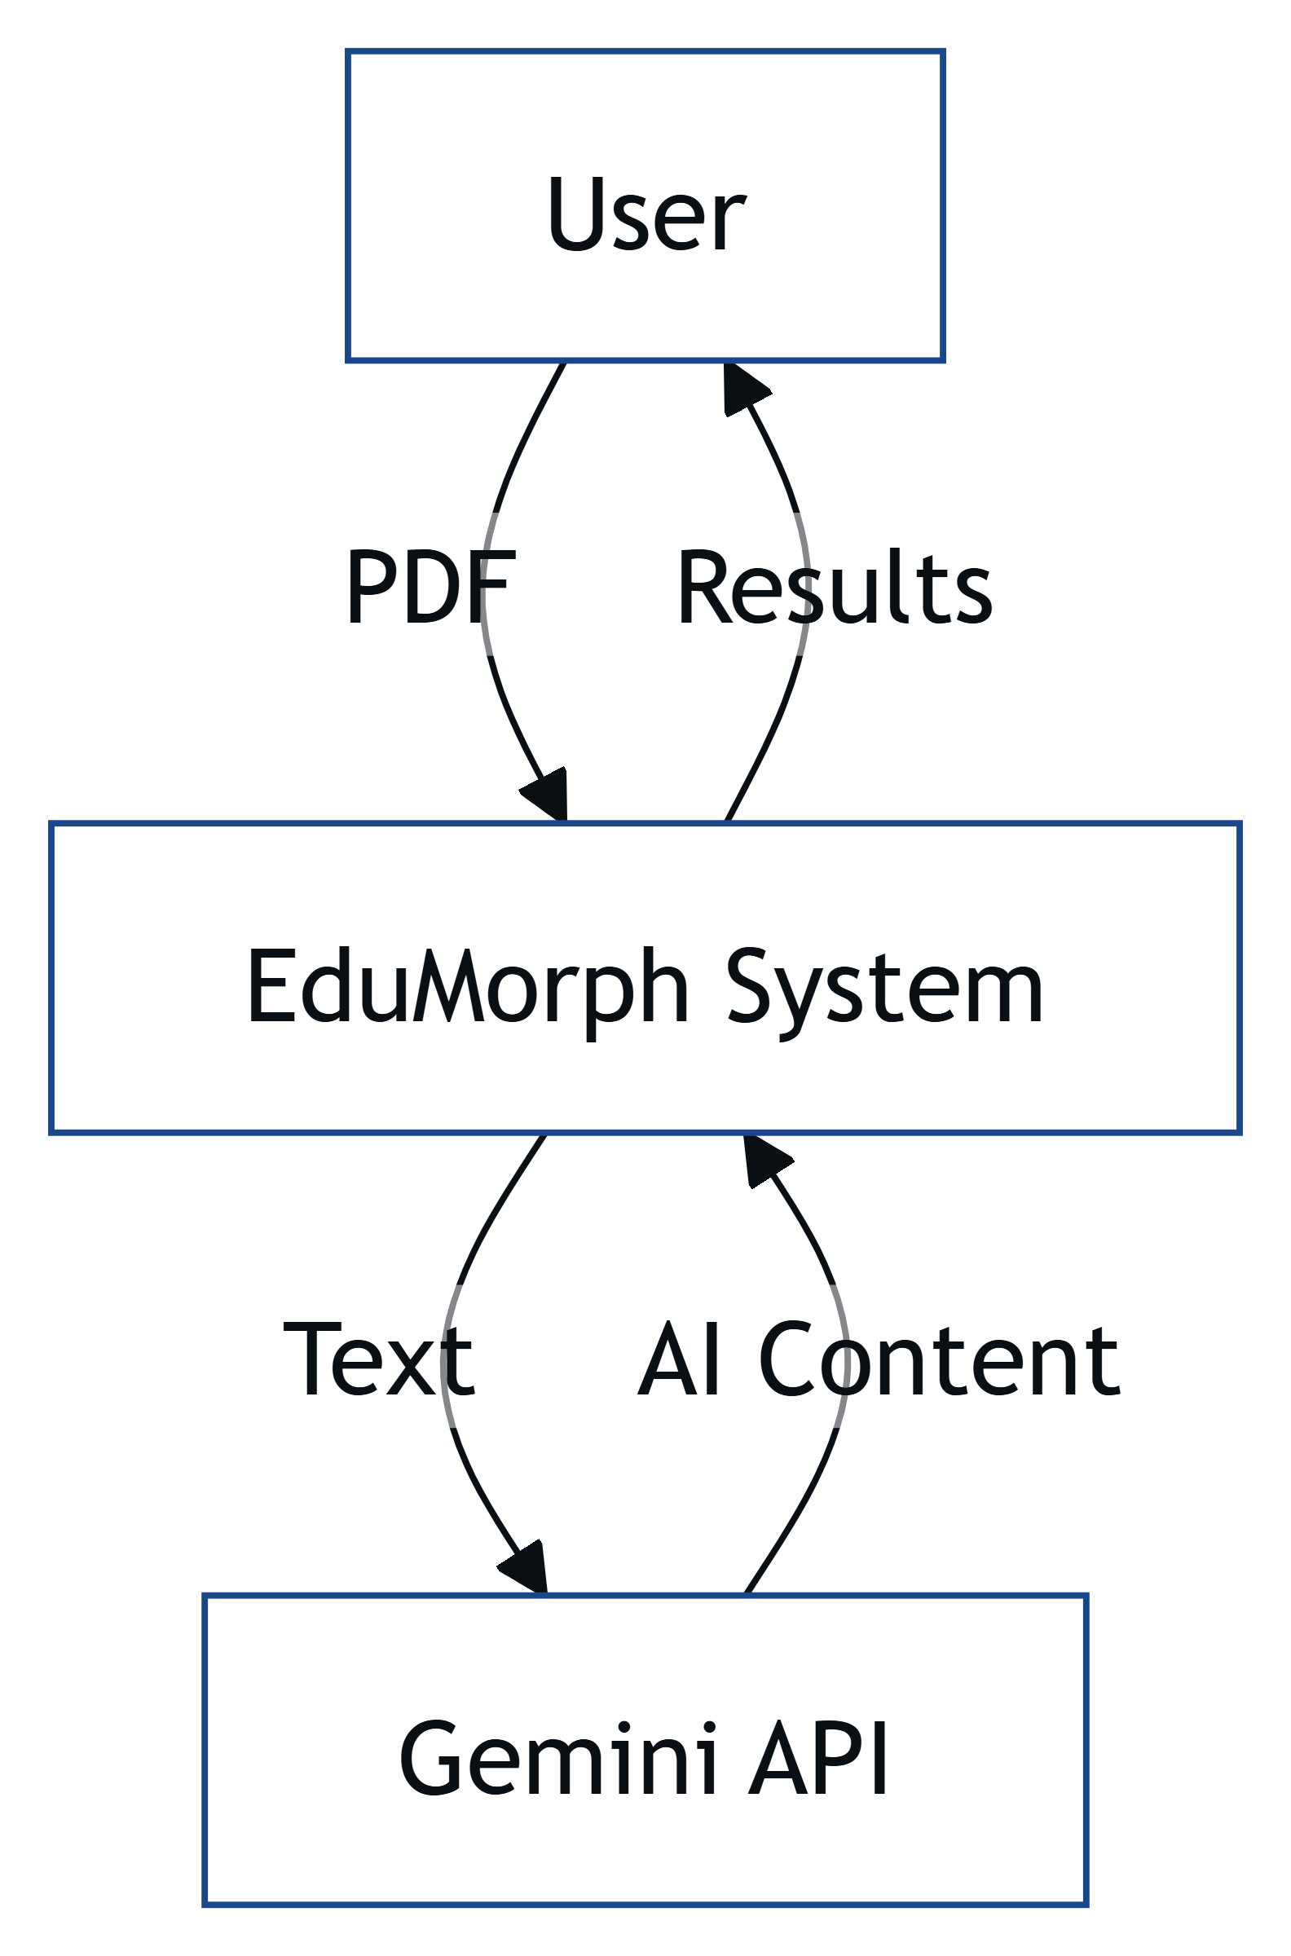
DATAFLOW DIAGRAM Level 0:

Slide 5
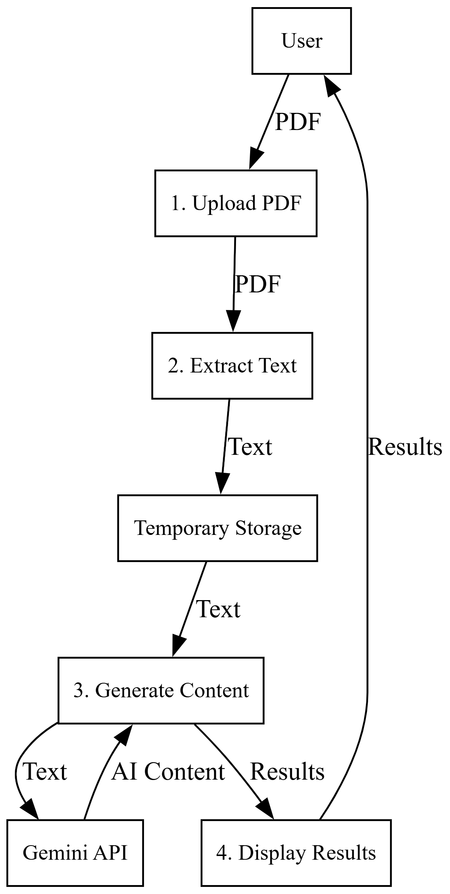
DATAFLOW DIAGRAM Level 1:

Slide 6
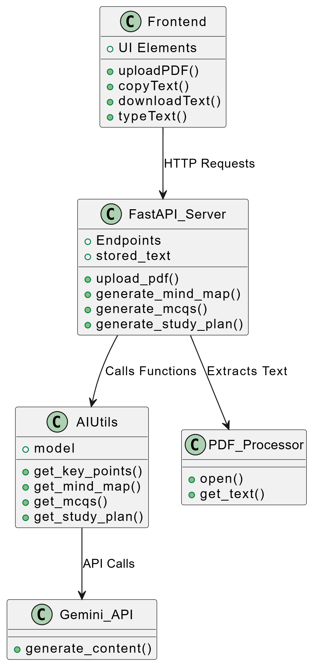
UML DIAGRAM

Slide 7
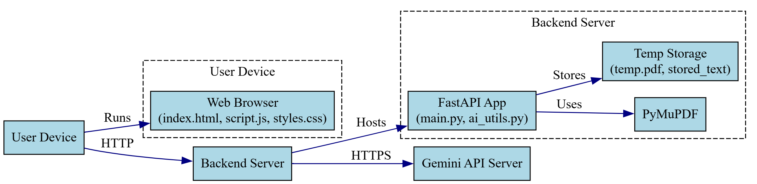
DEPLOYMENT DIAGRAM

Slide 8
SYSTEM MODULES
List of Modules:
File Input and Processing Module
AI Content Generation Module
Response Processing and Rendering Module
User Interaction and Feedback Module

Slide 9
FILE INPUT AND PROCESSING MODULE
EXAMPLE:
Sarah, a student, uses EduMorph to study her 10-page biology PDF on ecosystems. She clicks "Choose File" on the website, selects the PDF from her laptop, and clicks "Upload." The system receives the PDF and extracts text, producing a string like "Ecosystems include biotic and abiotic components. Forests have high biodiversity..." from the chapter.
This module allows a user to upload a PDF file through a web interface and extracts the text from it for further use. It provides a file selection field and button, sends the PDF to the server, and converts the PDF’s content into plain text by reading its pages.

Slide 10
AI CONTENT GENERATION MODULE
EXAMPLE:
Using the same biology PDF Sarah uploaded, the module sends the extracted text ("Ecosystems include biotic and abiotic components...") to the Gemini AI. The AI generates a 10-point summary (e.g., "Ecosystems consist of living and non-living parts"), a snippet of key sentences, a mind map outlining "Ecosystems -> Terrestrial -> Forests," five MCQs (e.g., "Which ecosystem has high biodiversity? A. Desert B. Forest C. Tundra D. Ocean"), and a 7-day study plan (e.g., "Day 1: Study forest ecosystems").
This module sends the extracted text to an AI model to create study aids like summaries, snippets, mind maps, MCQs, and study plans. It uses the Gemini API with tailored prompts to generate educational content based on the PDF’s text.

Slide 11
RESPONSE PROCESSING AND RENDERING MODULE
EXAMPLE:
For Sarah’s biology PDF, the module takes the AI’s outputs and formats them. The summary becomes a clean bullet list (e.g., "<li>Ecosystems consist of living and non-living parts</li>"), the mind map is structured as preformatted text, and MCQs are set up as clickable buttons. The website shows these in five styled sections (summary, snippet, mind map, MCQs, study plan) with a smooth fade-in effect, all based on the same ecosystems PDF.
This module cleans the AI’s raw outputs, formats them into structured content, and displays them on the website. It removes extra formatting, organizes the content into lists or hierarchies, and renders it as styled HTML elements with animations.

Slide 12
USER INTREACTION AND FEEDBACK MODULE
EXAMPLE:
Still working with Sarah’s biology PDF, the module lets her click the "B. Forest" button for the MCQ "Which ecosystem has high biodiversity?" The button turns green, showing "Correct! Forests have diverse species." She copies the summary to her clipboard for her notes and downloads the study plan as study_plan.txt. A green "✅ All done!" message confirms the processing of her ecosystems PDF, or a red "❌ Failed to process PDF" would appear if the file was corrupted.
This module lets users interact with the study aids and provides feedback on the process. It supports copying content, downloading files, answering MCQs with instant feedback, and showing status messages for success or errors.

Slide 13
THANK YOU

